Slide 1
3D Printing
Design to Finish
Overview

Slide 2
Tools Needed
Computer Aided Design (CAD)
Tinkercad.com used in this overview
Computer Aided Manufacturing (CAM or Slicer)
Simplify 3D Slicer used
3D Printer or 3D Printing Service
Ender 3 Pro printer used
Click to advance to next slide

Slide 3
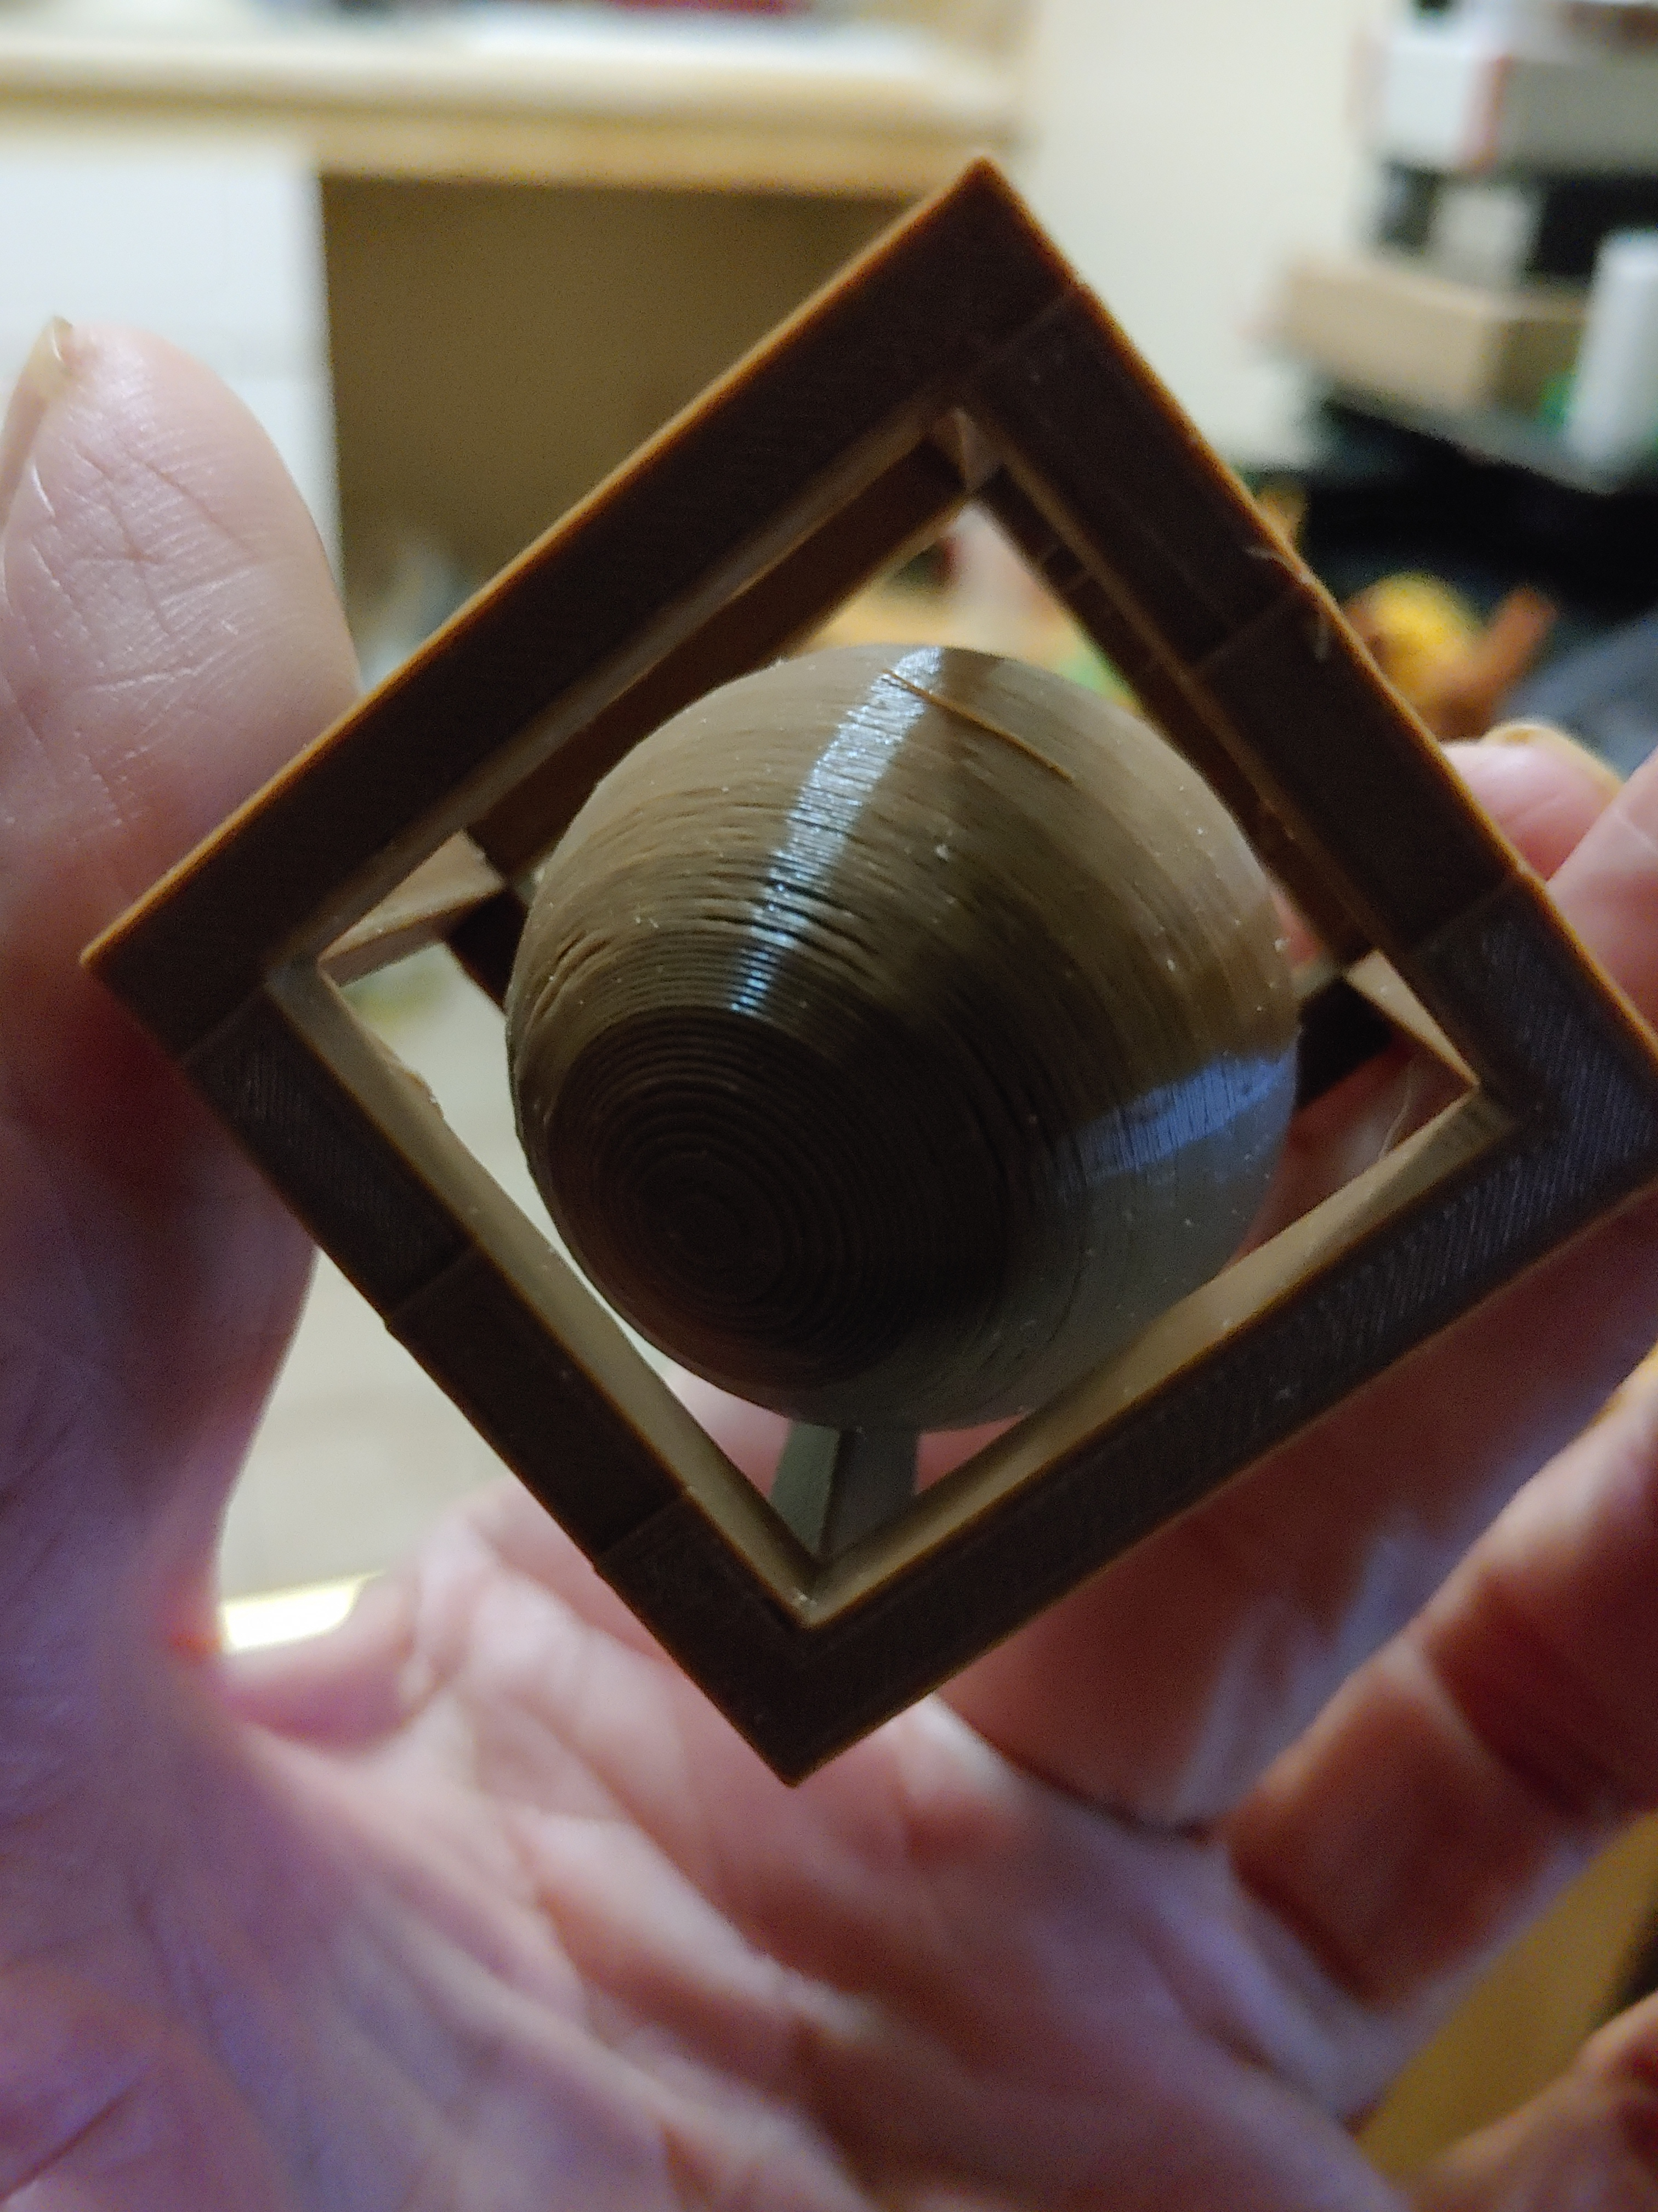
Sphere in a Cube
Steps:
Design with Tinkercad
Prepare to Print with
Simplify 3D slicer
Set up Material, Quality and Printer
G-Code (printer instructions)
Print
Click to advance to next slide

Slide 4
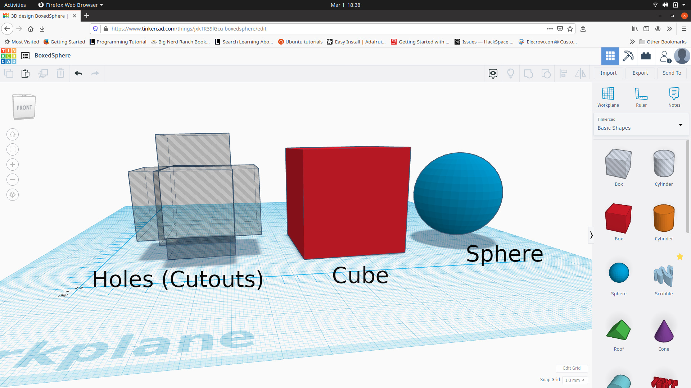
CAD Design
Set up the Shapes needed
- A solid Cube (40 mm X 40 mm X 40 mm)
- Holes to cutout sides of cube (cut holes 25 mm in all 6 sides of the cub
- Sphere for inside the cube (30 mm – to fit inside cube and movable)
Click to advance to next slide

Slide 5
CAD Design
Set up the Shapes needed
- A solid Cube (40 mm X 40 mm X 40 mm)
- Holes to cutout sides of cube (cut holes 25 mm in all 6 sides of the cub
- Sphere for inside the cube (30 mm – to fit inside cube and movable)
Click to advance to next slide

Slide 6
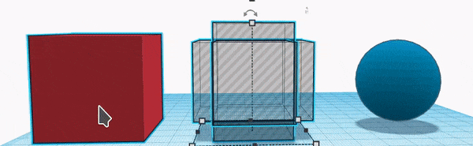
Use Align tools to center cutouts on the cube
Use Group tool to join cutouts and cube
Center the sphere with the cube
Use the Group tool to join together
The design is finished, export to CAM (Simplify 3D)
to prepare for printing
Click to advance to next slide

Slide 7
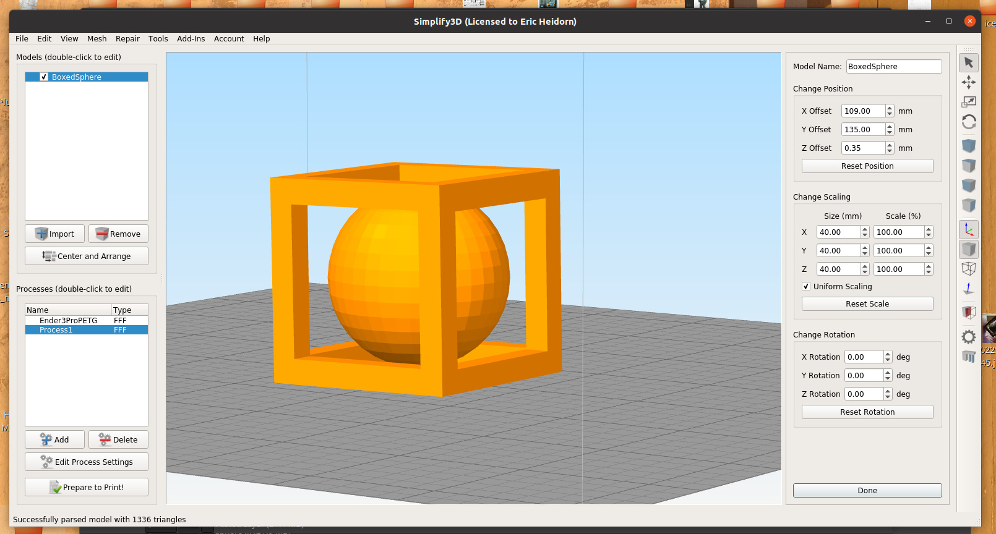
Simplify 3d Slicer (CAM)
Simplify 3D Computer Aided Manufacturing programs are used to set up all necessary materials used, quality and printing instructions (G-CODE) for the 3D printer
Click to advance to next slide

Slide 8
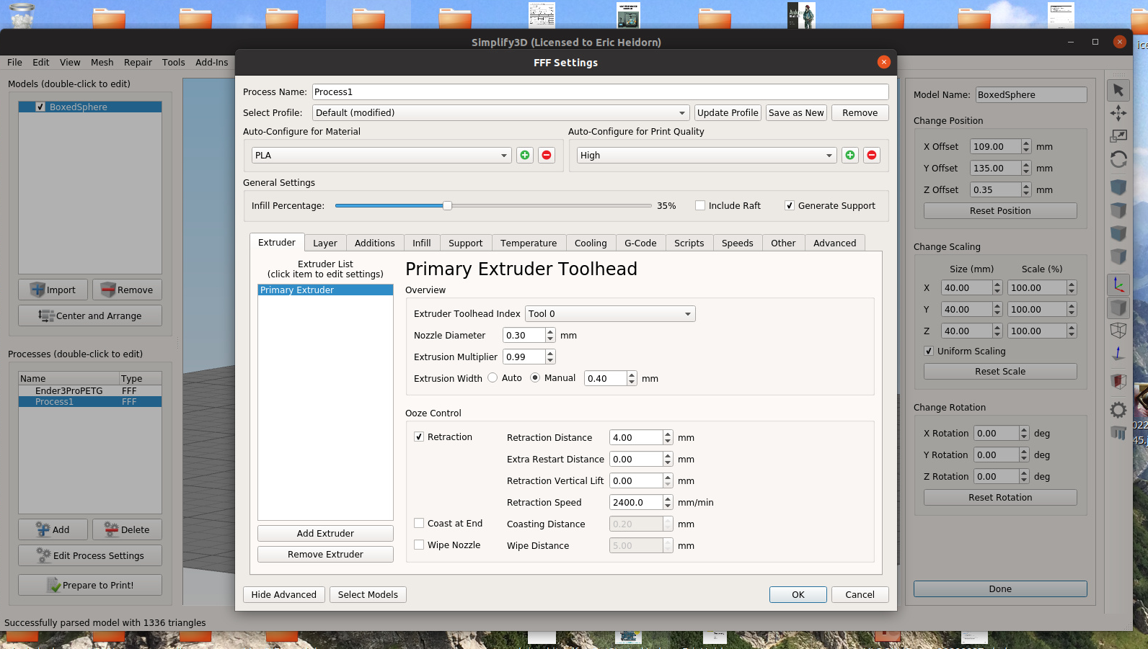
Simplify 3d Slicer (CAM)
Set up screen for material, infill, quality and temperature
Click to advance to next slide

Slide 9
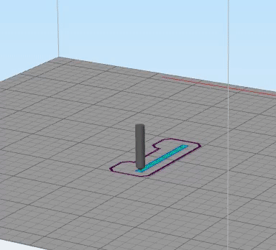
Test Print (Simulated)
A simulated test print to insure design
will print correctly
Click to advance to next slide

Slide 10
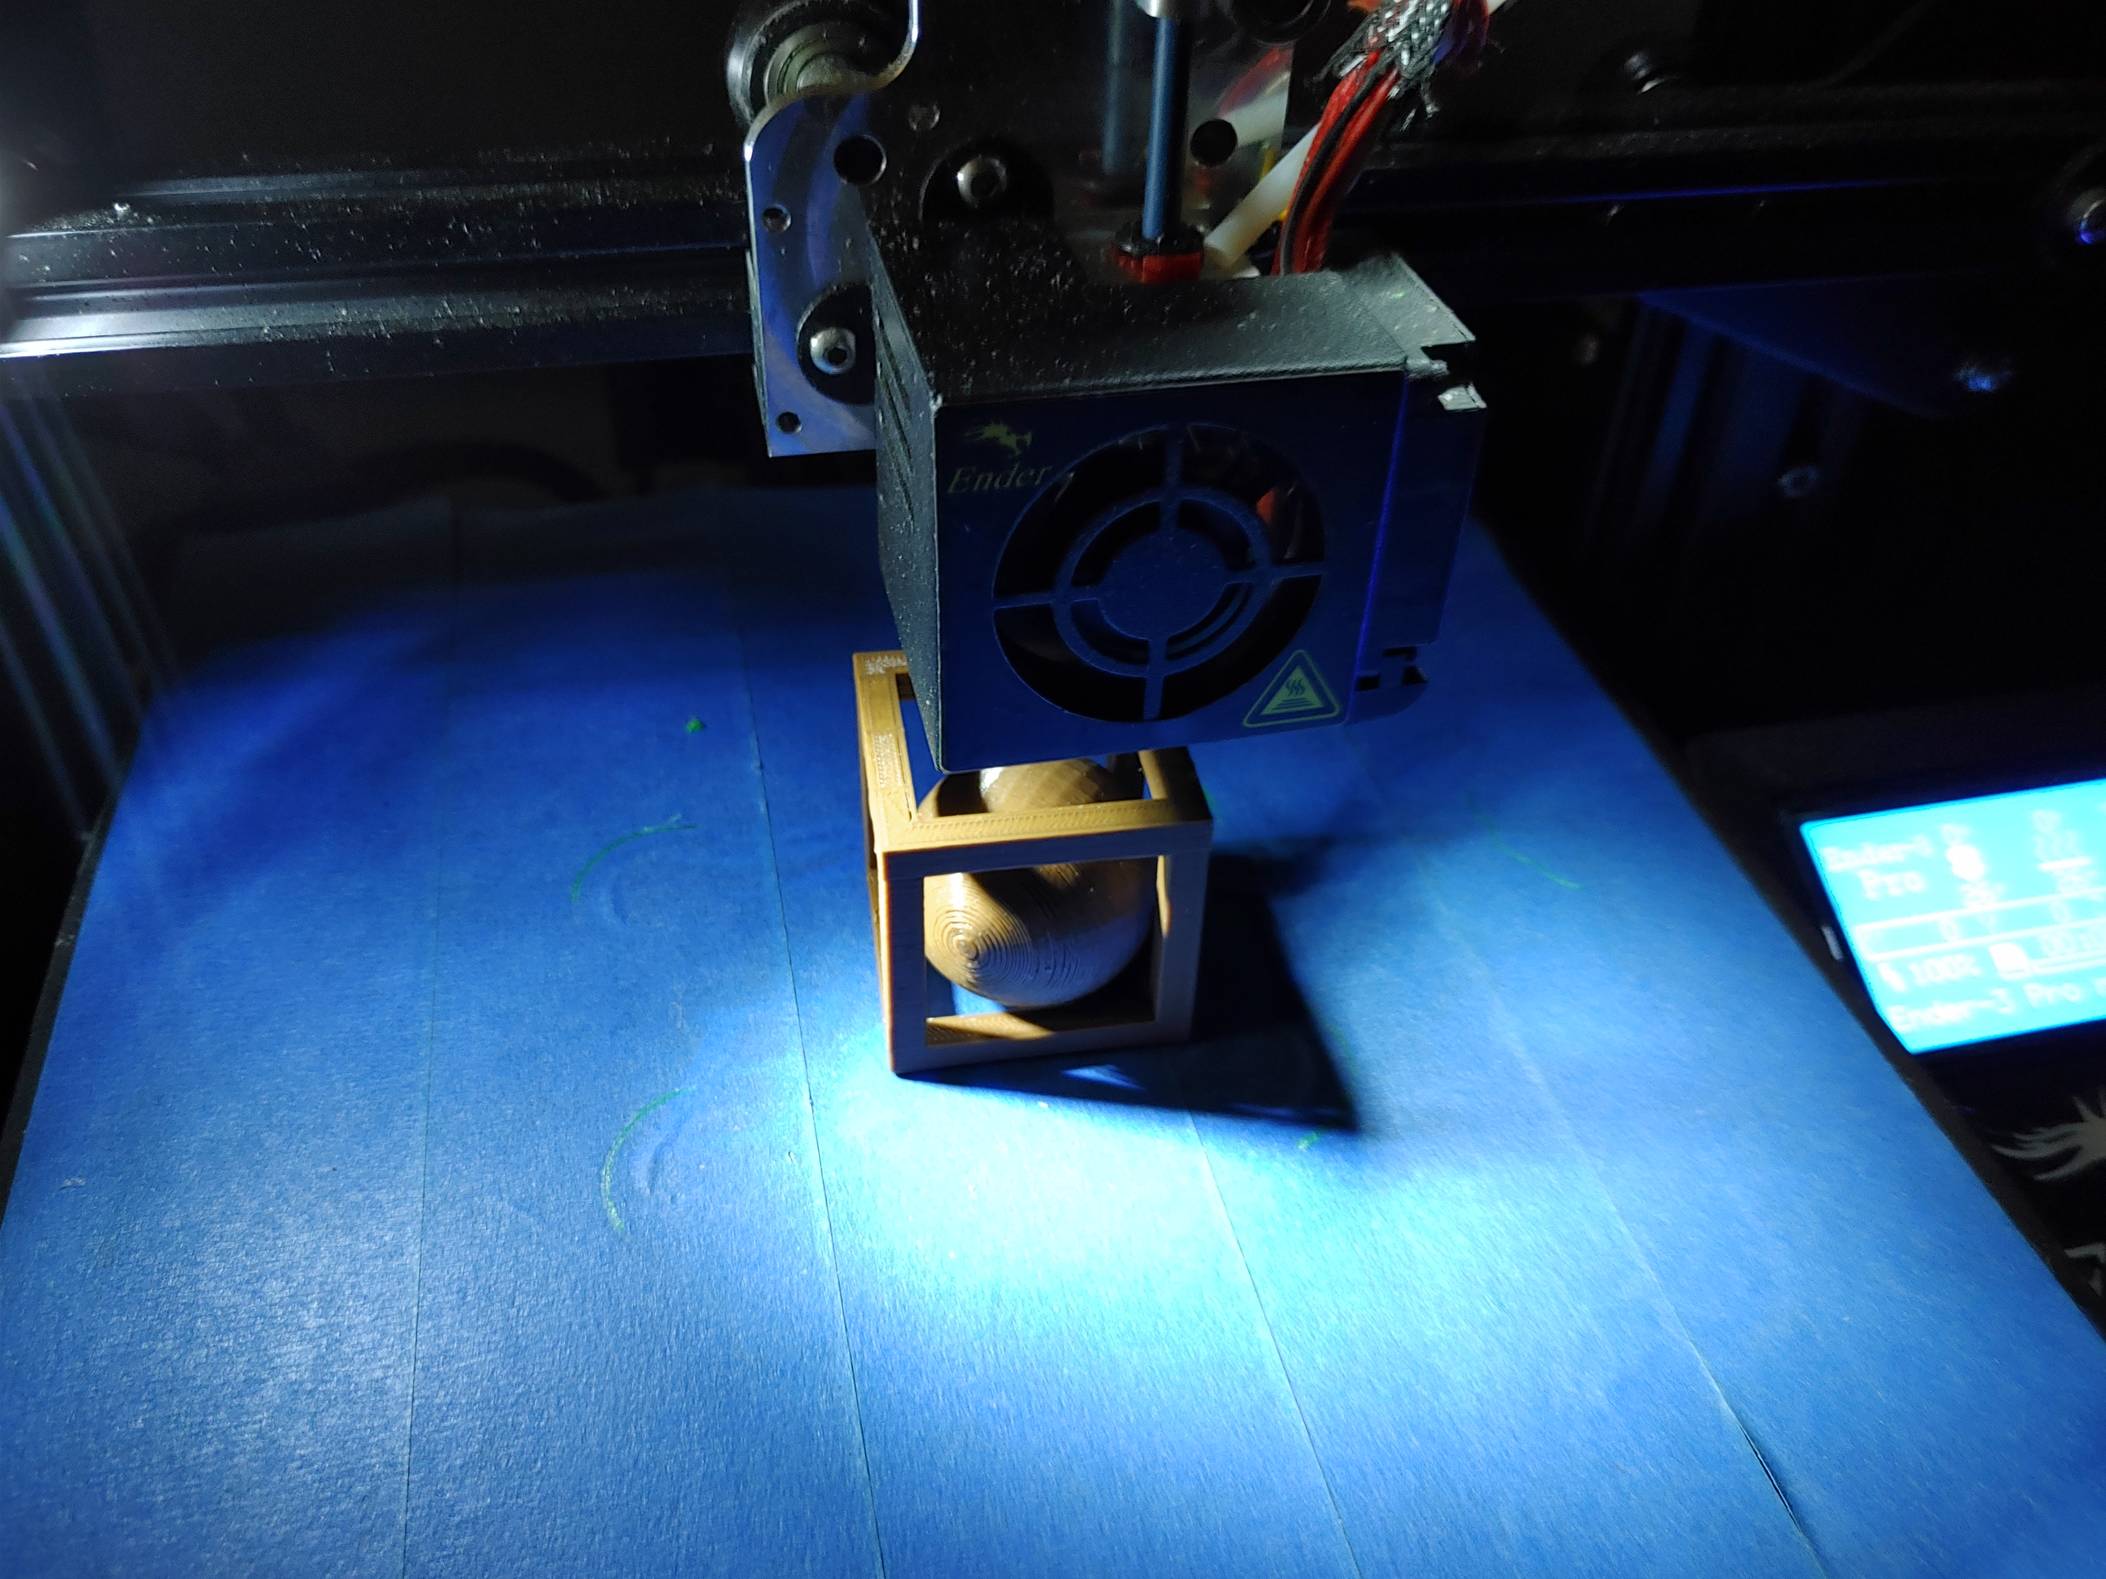
Finished Printing
Click to advance to next slide

Slide 11
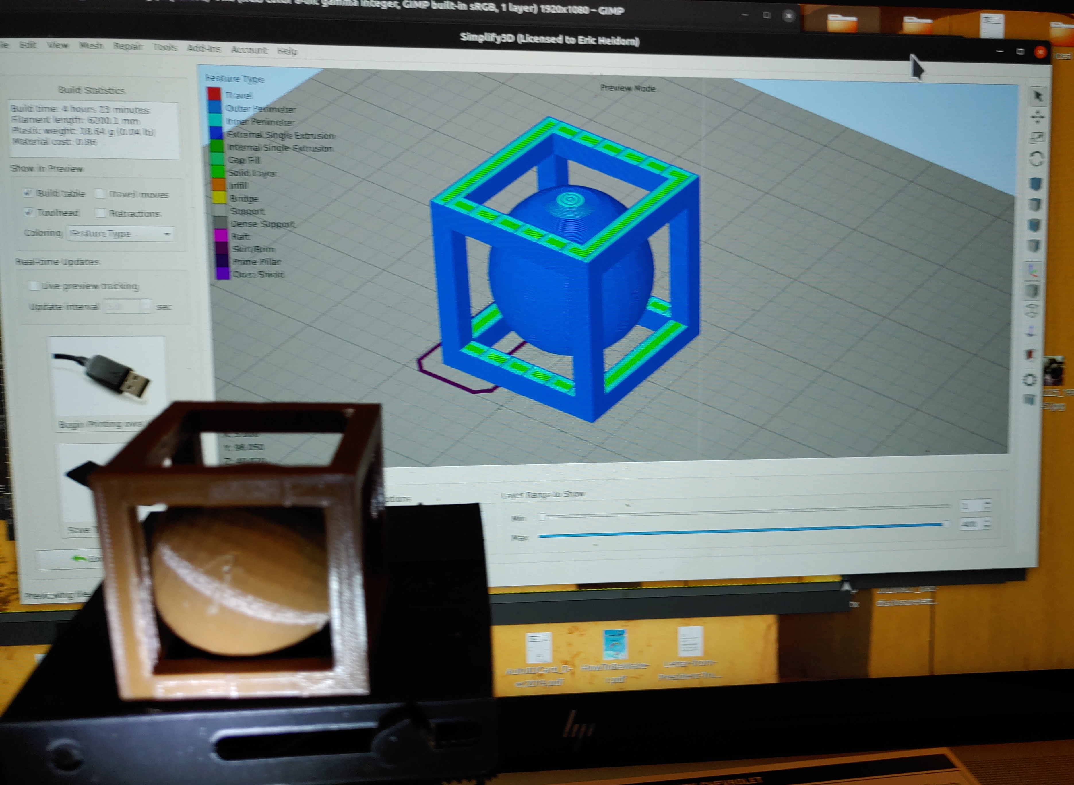
Finished Printing
Click to advance to next slide

